Slide 1

Fuzzy logic on GNU/Linux Operative System
Eng. Andrés M. Prieto Álvarez

Slide 2
What is fuzzy logic?
Fuzzy logic is an extension of classical logic that allows us to handle truth values ​​that are not just 0 or 1 (true or false), but values ​​intermediate between the two.
1
Lotfi Zadeh, 1965
0

Slide 3


What does it work for?
It is used when we need to model complex situations where decisions are not simply black and white.
It allows decisions to be made in uncertain situations, which is useful in control systems, artificial intelligence and machine learning.
Management of processes, resources and automatic adjustments according to current conditions.

Slide 4
Common hardware utilities for GNU/Linux OS that uses Fuzzy logic

Slide 5
Libprocess
Ref: https://github.com/3rdparty/libprocess

Slide 6
Implementation examples of Libprocess
lm-sensors
lm-sensors implements libprocess to get the temperature of the PC then identify if there’s some over warm, also it gets other measures like CPU usage, RAM usage or energy consumption, etc
Ref: https://github.com/lm-sensors/lm-sensors
Fancontrol
This package implements libprocess for getting temperature measurement, then turning on fans if that’s required, checking power and energy consumption over the fans velocity in the cooling system
Ref: https://packages.debian.org/search?keywords=fancontrol

Slide 7
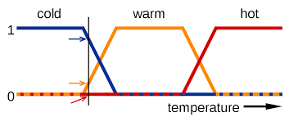
How does it work?

Slide 8
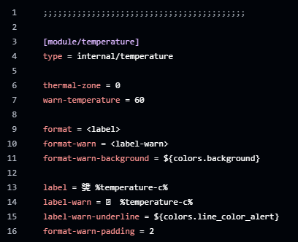

Labeling scale implementation for a widget
Ref: https://github.com/AndresMpa/dotfiles

Slide 9
Fuzzy logic on GNU/Linux terminal

Slide 10

F - Fuzzy - Finder/Search
FZF is a fuzzy finder implemented in different OS, packages, command line, editors, etc. It works to make fuzzy search using a given text.
Ref: https://github.com/junegunn/fzf

Slide 11
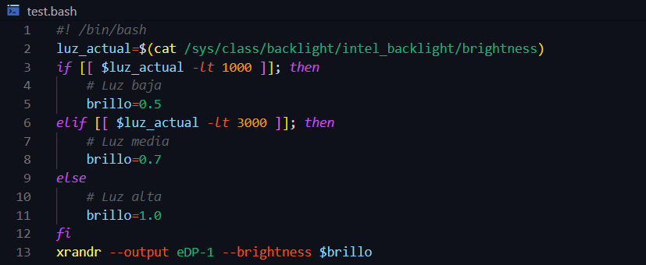
Brightness control script
Ref: https://github.com/junegunn/fzf

Slide 12
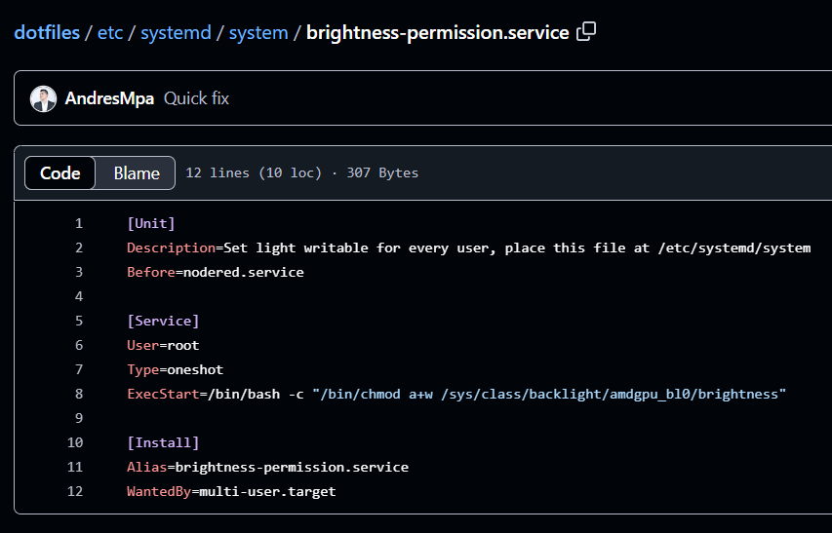
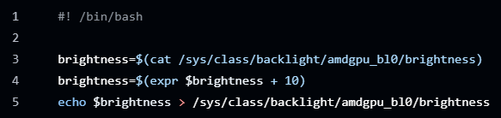
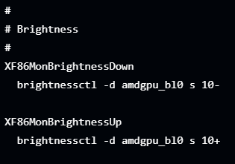
Regarding the permission system

Slide 13
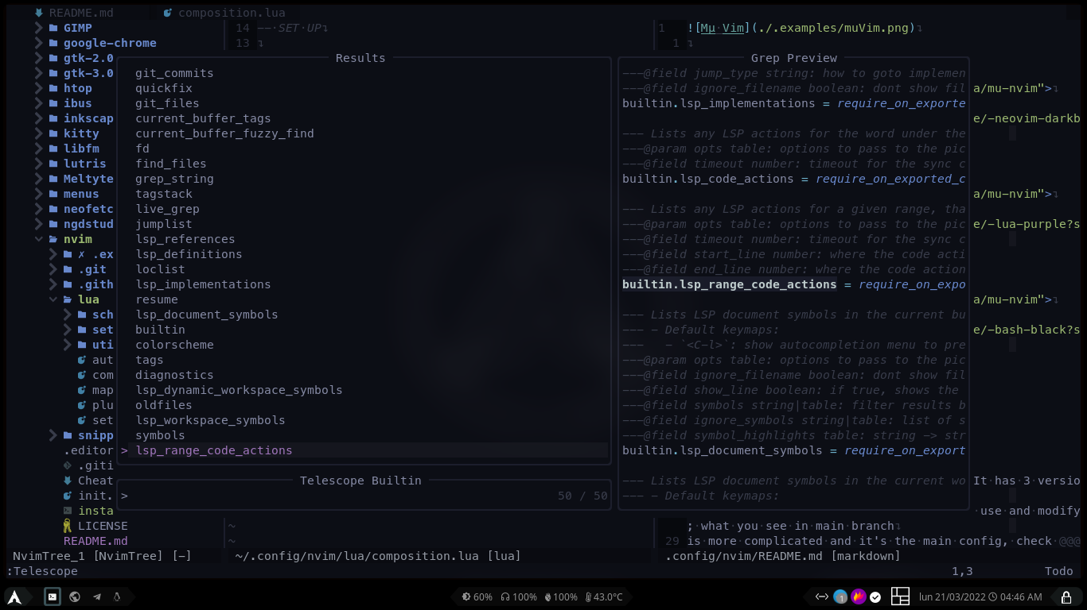
Other fuzzy search implementation regarding different context

Slide 14
Thank you
Eng. Andrés M. Prieto Álvarez

